Slide 1
ICS 141 – Programming With Objects
Lecture 2(reset) – Robert Jahn
Based on the slides of Dr. Daniel Liang

Slide 2
Schedule
April 1st: Abstract classes, interfaces, ArrayList
April 8th: Recursion
April 15th: Exception Handling
April 22nd: File I/O
April 29th: Final Exam

Slide 3
Interfaces
What is an interface?
Why is an interface useful?
How do you define an interface?
How do you use an interface?

Slide 4
What is an interface? Why is an interface useful?
An interface is a class like construct that contains only constants and abstract methods. In many ways, an interface is similar to an abstract class, but the intent of an interface is to specify behavior for objects. For example, you can specify that the objects are comparable, edible, cloneable using appropriate interfaces.

Slide 5
Define an Interface
To distinguish an interface from a class, Java uses the following syntax to define an interface:
public interface InterfaceName {
constant declarations;
method signatures;
}
Example:
public interface Edible {
/** Describe how to eat */
public abstract String howToEat();
}

Slide 6
Interface is a Special Class
An interface is treated like a special class in Java.
Like an abstract class, you cannot create an instance from an interface using the new operator, but in most cases you can use an interface more or less the same way you use an abstract class.
For example, you can use an interface as a data type for a variable, as the result of casting, and so on.
One major difference is that we can implement multiple interfaces.
This allows us to mimic multiple inheritance.

Slide 7
Example
You can now use the Edible interface to specify whether an object is edible. This is accomplished by letting the class for the object implement this interface using the implements keyword. For example, the classes Chicken and Fruit implement the Edible interface.

Slide 8

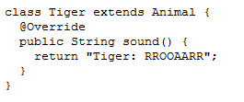
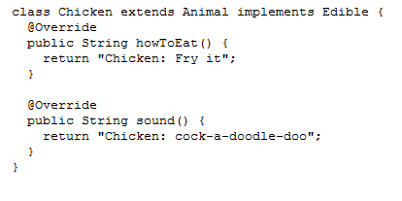
public interface Edible {
/** Describe how to eat */
public abstract String howToEat();
}

Slide 9

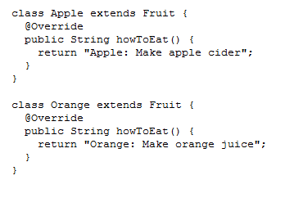
public interface Edible {
/** Describe how to eat */
public abstract String howToEat();
}

Slide 10
Omitting Modifiers in Interfaces
All data fields are public final static and all methods are public abstract in an interface. For this reason, these modifiers can be omitted, as shown below:
A constant defined in an interface can be accessed using syntax InterfaceName.CONSTANT_NAME (e.g., T1.K).

Slide 11
Interfaces vs. Abstract Classes
In an interface, the data must be constants; an abstract class can have all types of data.
Each method in an interface has only a signature without implementation; an abstract class can have concrete methods.
 | Variables | Constructors | Methods
Abstract class | No restrictions | Constructors are invoked by subclasses through constructor chaining. An abstract class cannot be instantiated using the new operator. | No restrictions.
Interface | All variables must be public static final | No constructors. An interface cannot be instantiated using the new operator. | All methods must be public abstract instance methods

Slide 12
Interfaces vs. Abstract Classes, cont.
All classes share a single root, the Object class, but there is no single root for interfaces. Like a class, an interface also defines a type. A variable of an interface type can reference any instance of the class that implements the interface. If a class implements an interface, this interface plays the same role as a superclass. You can use an interface as a data type and cast a variable of an interface type to its subclass, and vice versa.
Suppose that c is an instance of Class2. c is also an instance of Object, Class1, Interface1, Interface1_1, Interface1_2, Interface2_1, and Interface2_2.

Slide 13
Caution: conflict interfaces
In rare occasions, a class may implement two interfaces with conflict information (e.g., two same constants with different values or two methods with same signature but different return type). This type of error will be detected by the compiler.

Slide 14
Whether to use an interface or a class?
Abstract classes and interfaces can both be used to model common features. How do you decide whether to use an interface or a class? In general, a strong is-a relationship that clearly describes a parent-child relationship should be modeled using classes. For example, a staff member is a person. So their relationship should be modeled using class inheritance. A weak is-a relationship, also known as an is-kind-of relationship, indicates that an object possesses a certain property. A weak is-a relationship can be modeled using interfaces.

Slide 15
Recursion
A very simple concept in words, but can become quite complex and difficult to reason about.
Recursion is the idea of a method calling itself…
i.e., we have a method called m1(). At some point in its execution, m1() calls itself.
Let’s code up a few examples…
I’ll add the examples to this lecture as we go along…

